Slide 1
Cardano ADA Price Prediction
Subject Name- Applications of Artificial Intelligence
Subject Code- EAI6010
By: Covid Resistant Husky Group 3
- Aayushi Gupta
- Atharva Kulkarni
- Sai Prathap Reddy Cheluri
- Shivani Sharma
- Srinidhi Karichalra

Slide 2
Table of Contents
What is Crypto currency?
What is Cardano ADA?
About our project
Data extraction and processing
Data Visualization and analysis
AI models applied
Conclusion and future scope

Slide 3
What is Cryptocurrency?
A digital means of exchange that is encrypted and decentralized
No central authority to manage and maintain the value of cryptocurrency.
To prevent fraud each transaction is checked by two validations, i.e, Proof of work or Proof of stake.
Proof of work: Method whereby verifying transaction on a blockchain where miners try and solve the block.
Proof of stake, to Reduce the amount of power utilization in POW, POS verifies the transaction by keeping the crypto in temporary lock up.

Slide 4
Cardano(ADA)
Cardano is a decentralized third-generation proof-of-stake blockchain platform.
Cardano uses Ouroboros—a proof-of-stake algorithm—to create blocks and validate transactions occurring on its blockchain.
"Ada" is Cardano's digital currency and is named after Ada Lovelace, a 19th-century countess and English mathematician who is recognized as the first computer programmer.
Cardano is a blockchain here are about 45 billion ADA supply and around 32 billion in circulation.

Slide 5
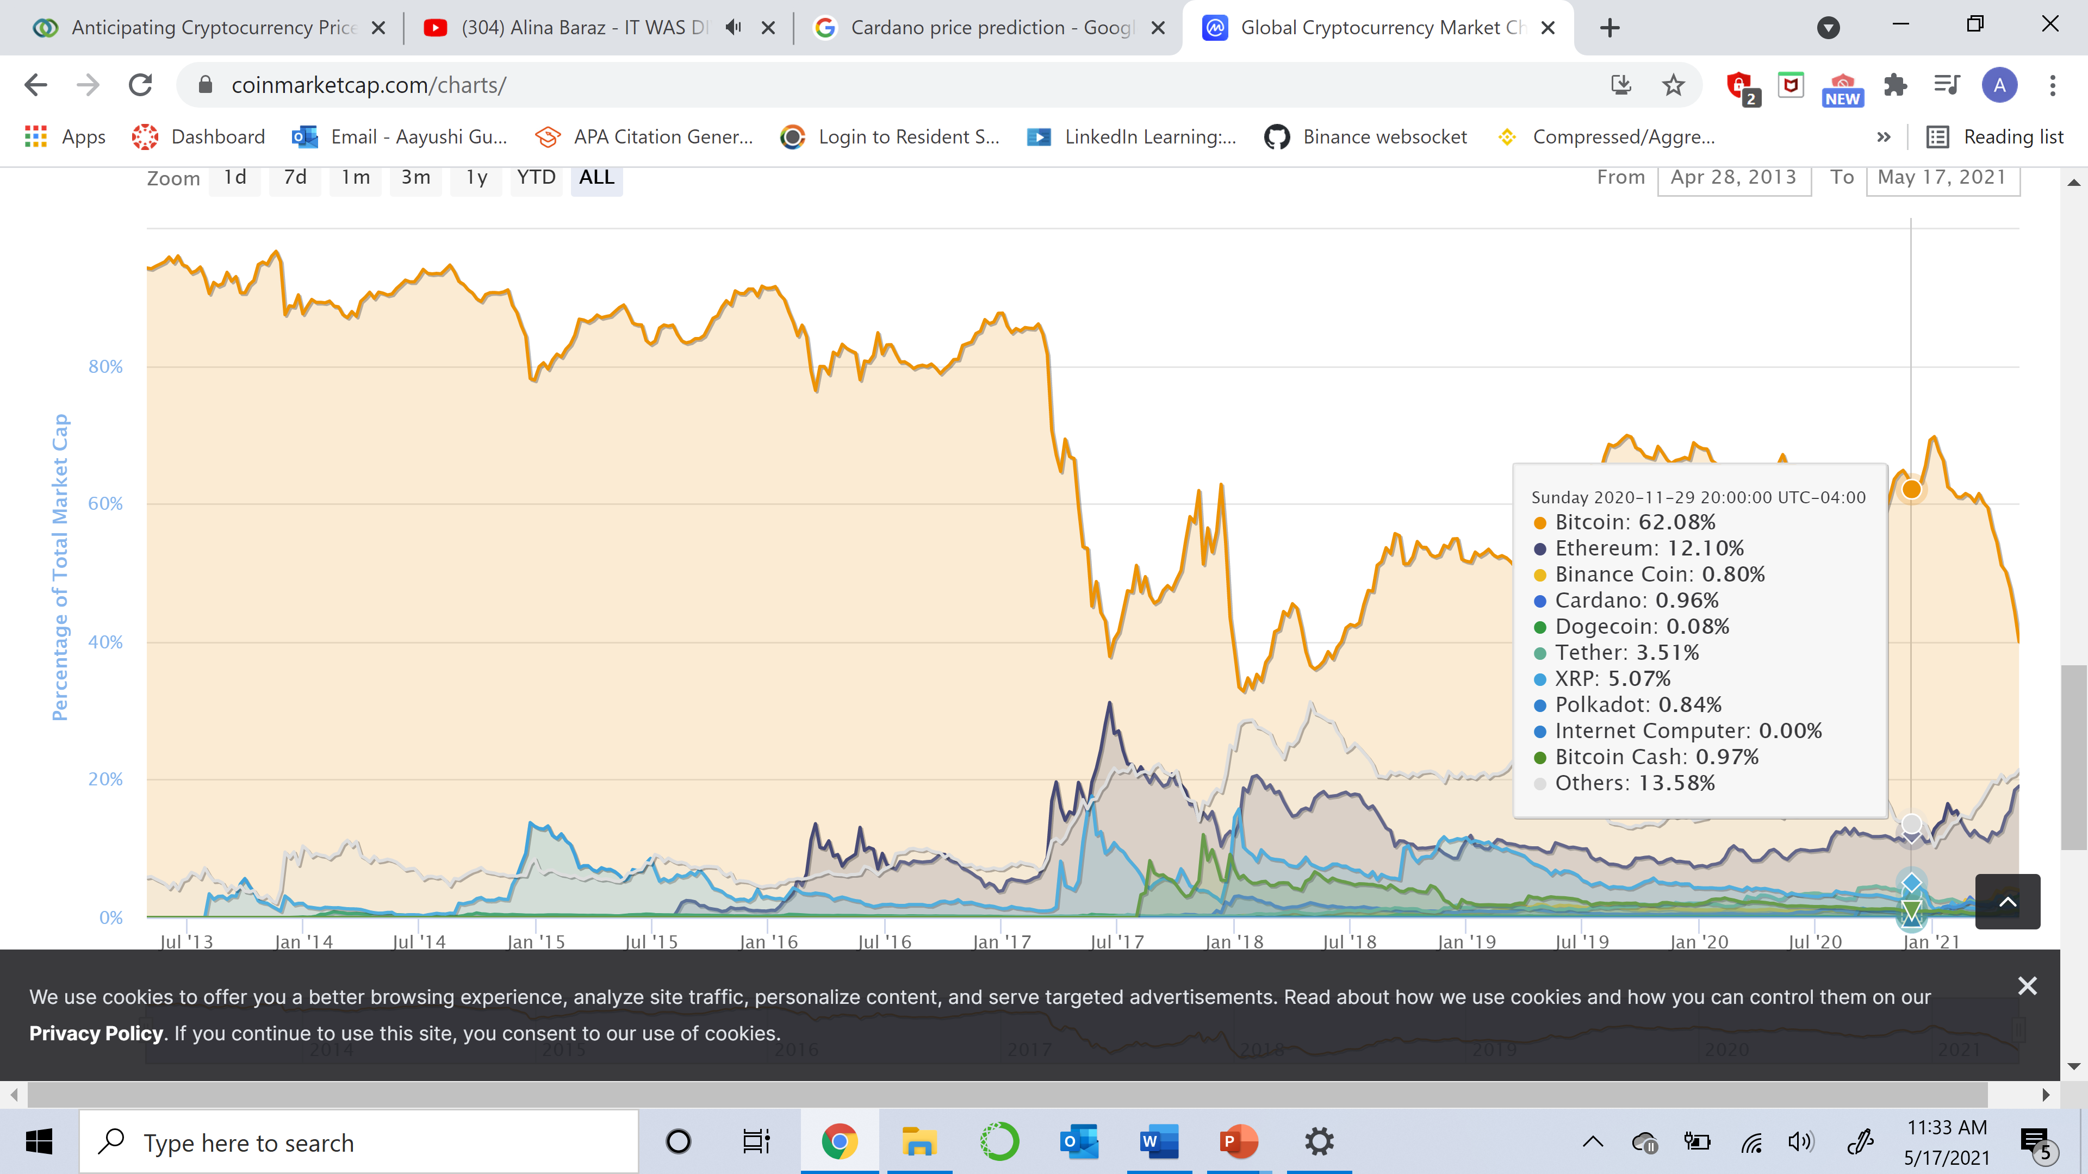

Slide 6
About our Project
Aim : To determine the closing price of Cardano(ADA) using the open, high, low prices and the volume.
Models used: LSTM and GRU
Programming language used: Python
Modules, API’s and libraries invoked- Keras, Tensorflow, Python-Binance, Scikit-Learn, Matplotlib, Plotly, Mplfinance

Slide 7

Methodology
Data Extraction
Data Processing
Data Visualization
Data Analysis
Data Modelling
Prediction and evaluation

Slide 8
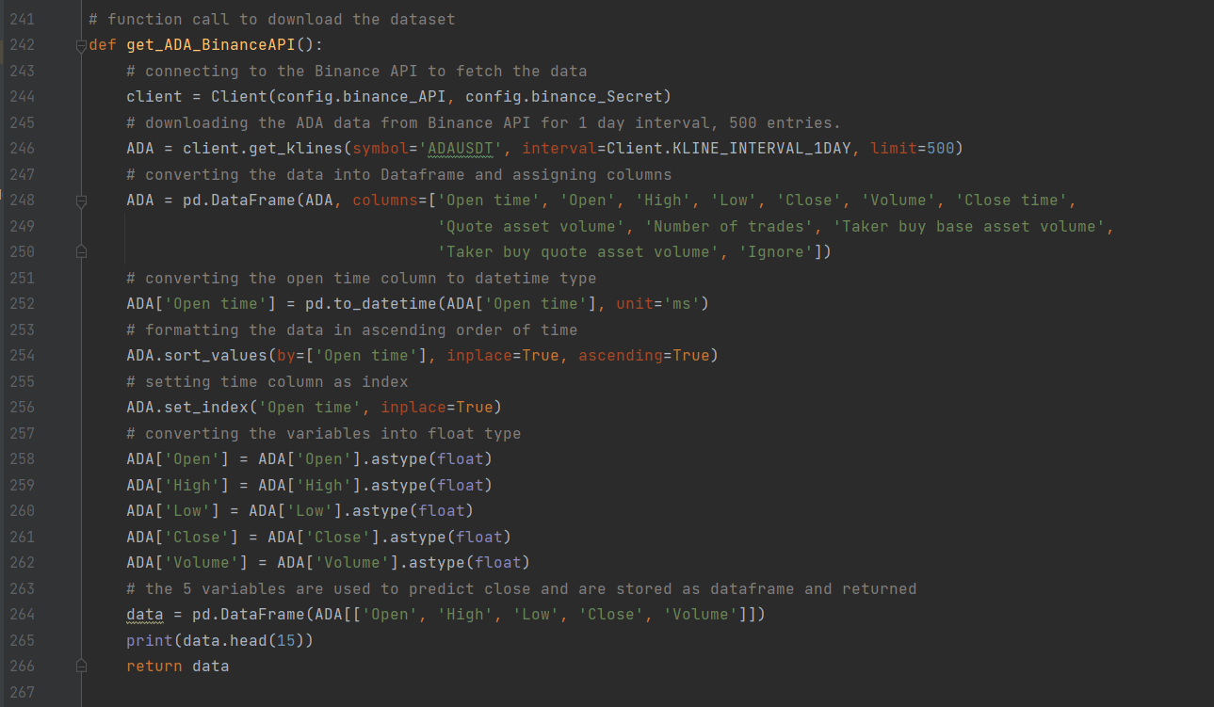
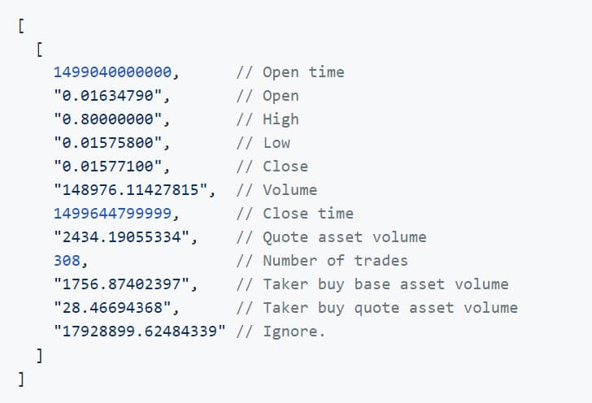
Data Extraction
Our project fetches data from Binance using the Python-Binance API.
The Binance API is a method that allows us to connect to the Binance servers via Python or several other programming languages.
Data extraction makes it possible to consolidate, process, and refine data so that it can be stored in a centralized location to be transformed.
Notes:
We are using the kline method to extract data for ADA crypto for one day interval.

Slide 9
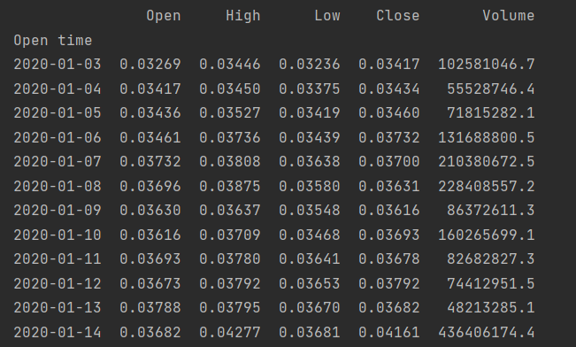
Data Processing
Extracting the relevant columns: Open Time, Open, High, Low, Close, Volume
Indexing: ‘Open Time’ as Index
Converted datatype of object to float and using datetime method to convert timestamp into date format.

Slide 10
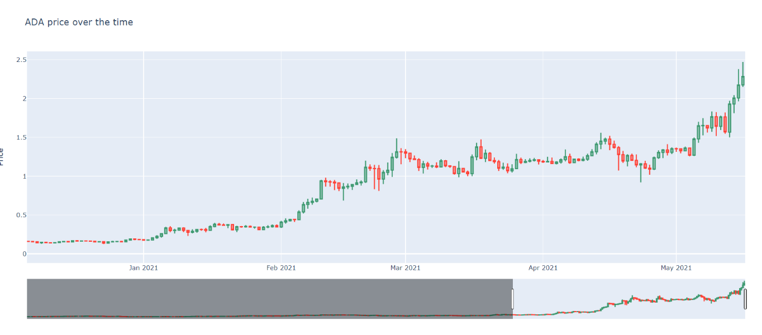
Data Visualization
The plotly library was imported to plot the candlestick chart. A candlestick is a type of price chart used in technical analysis that displays the high, low, open, and closing prices of a security for a specific period.

Slide 11
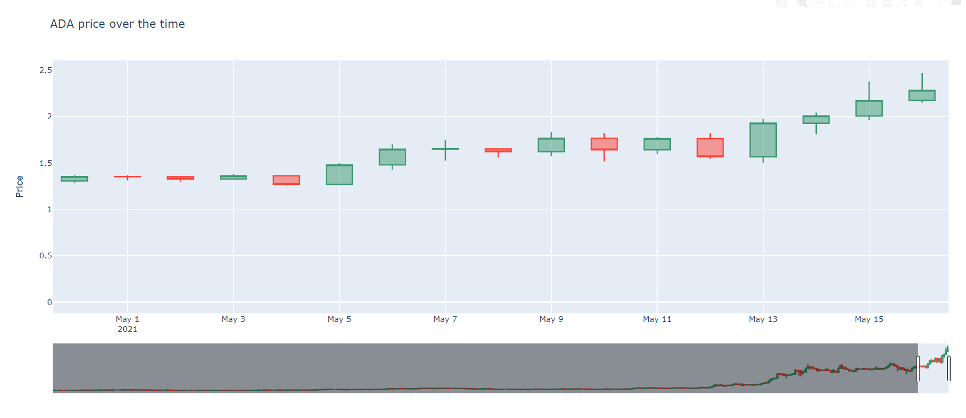
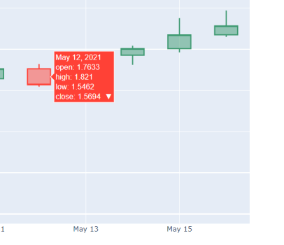
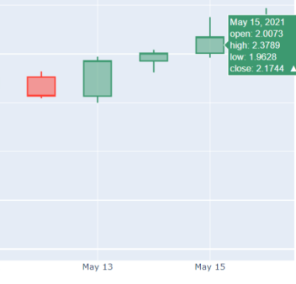
Notes:
A green candlestick means that the opening price on that day was lower than the closing price that day (i.e. the price moved up during the day); a red candlestick means that the opening price was higher than the closing price that day (i.e. the price moved down during the day).

Slide 12
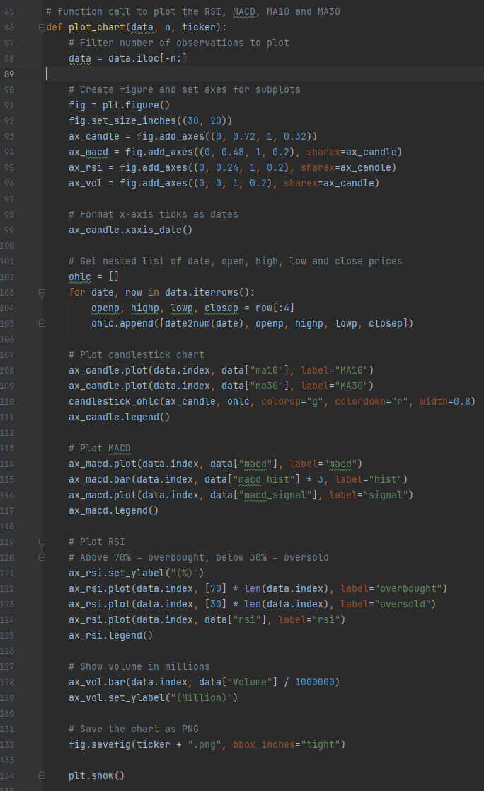
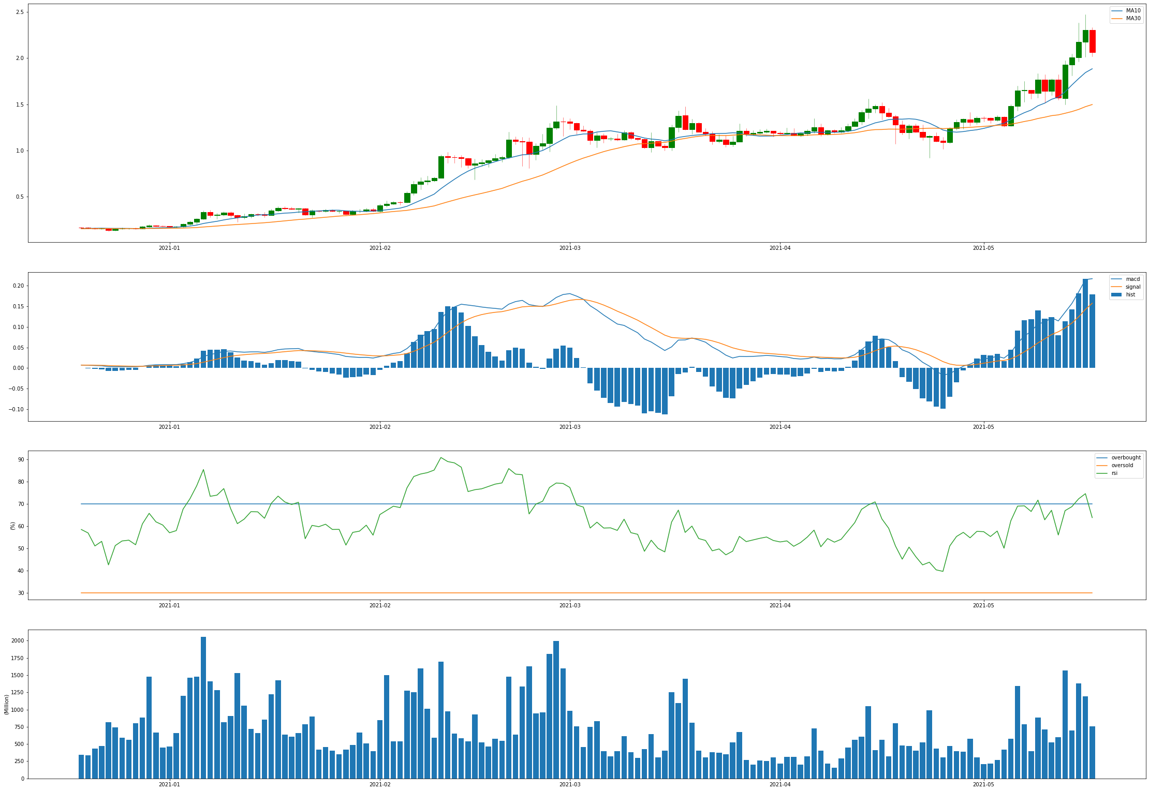
Data Analysis

Slide 13
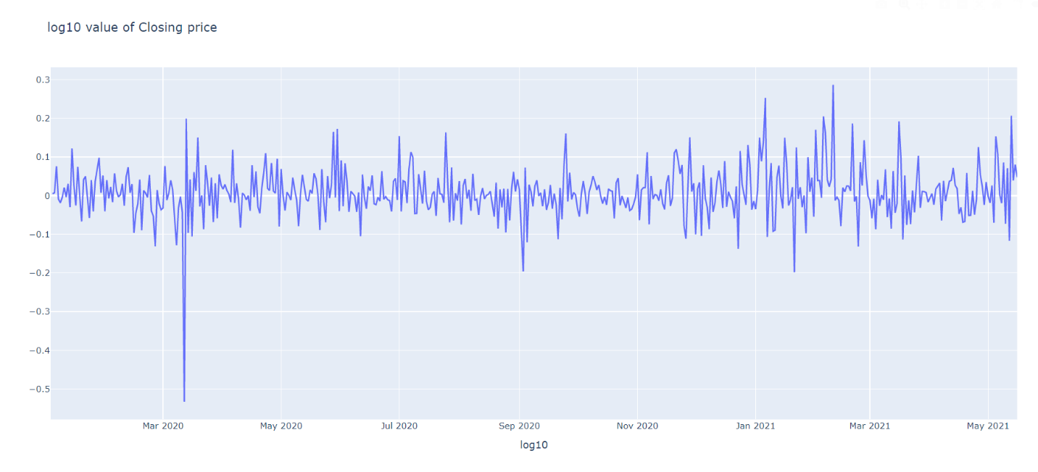
Log10 values
A logarithmic price scale is a type of scale used on a chart that is plotted such that two equivalent price changes are represented by the same vertical distance on the scale. The distance between the numbers on the scale decreases as the price of the asset increases. They are used for long-term perspective analysis of price changes

Slide 14

Applying the LSTM Model
An LSTM layer consists of a set of recurrently connected blocks, known as memory blocks.
It has three gates- the input, output and forget gate.
Training: Testing Ratio- 80:20
Number of layers- 2 with 300 nodes each
Activation function used- ReLu
Dropout- 20%
The dense layer which connects input to output has 1 output as we are only predicting 1 output variable

Slide 15
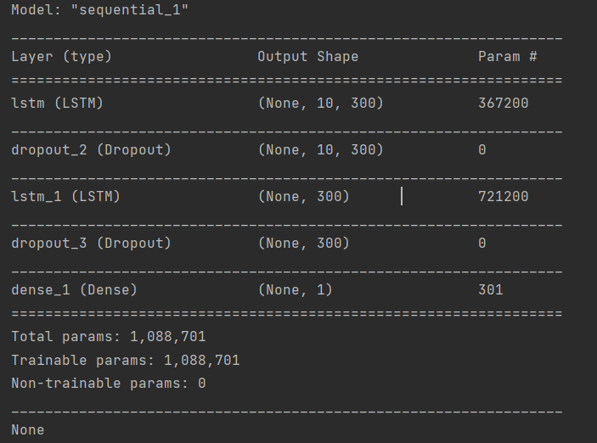
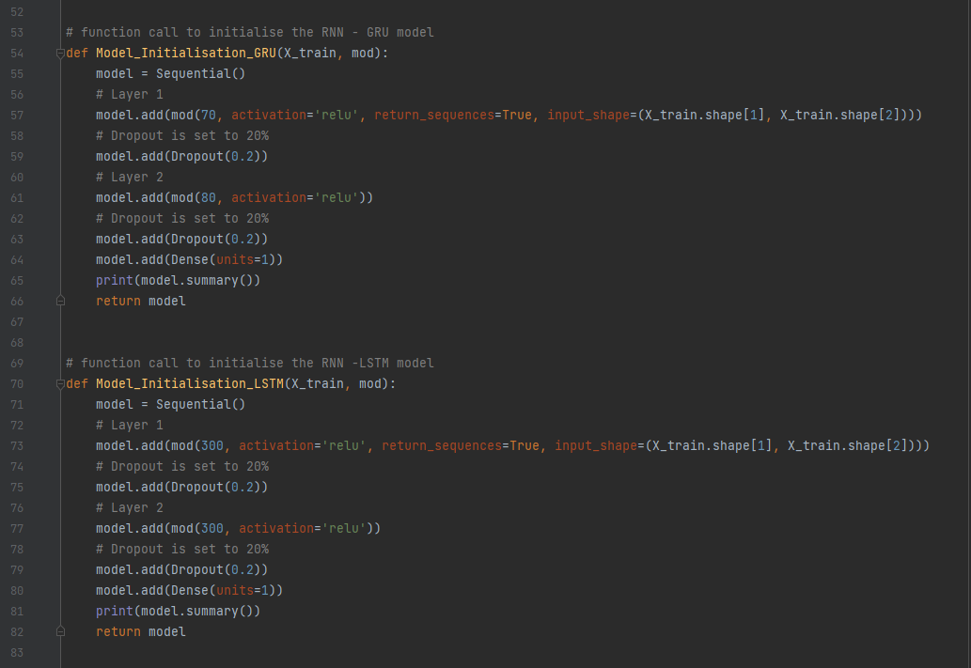

Slide 16
Applying the GRU Model
GRU(Gated Recuurent unit) solve the problem of vanishing gradient by utilizing two gates- The update gate and the reset gate.
Model Initialization is same as GRU except number of nodes in each layer.
Nodes in 1st layer: 70
Nodes in 2nd layer : 80
Window size: 10
Notes:
the window size is set to 10 to calculates the 10-day closing price considering the previous 9 day values.

Slide 17
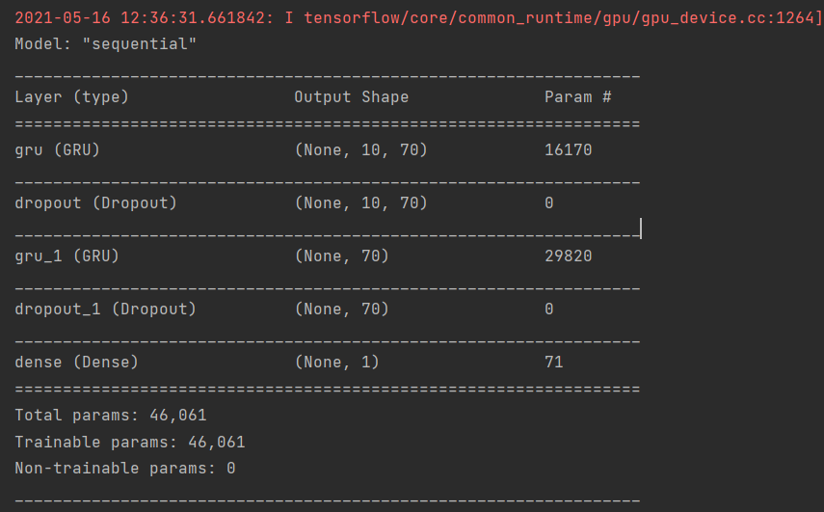

Slide 18
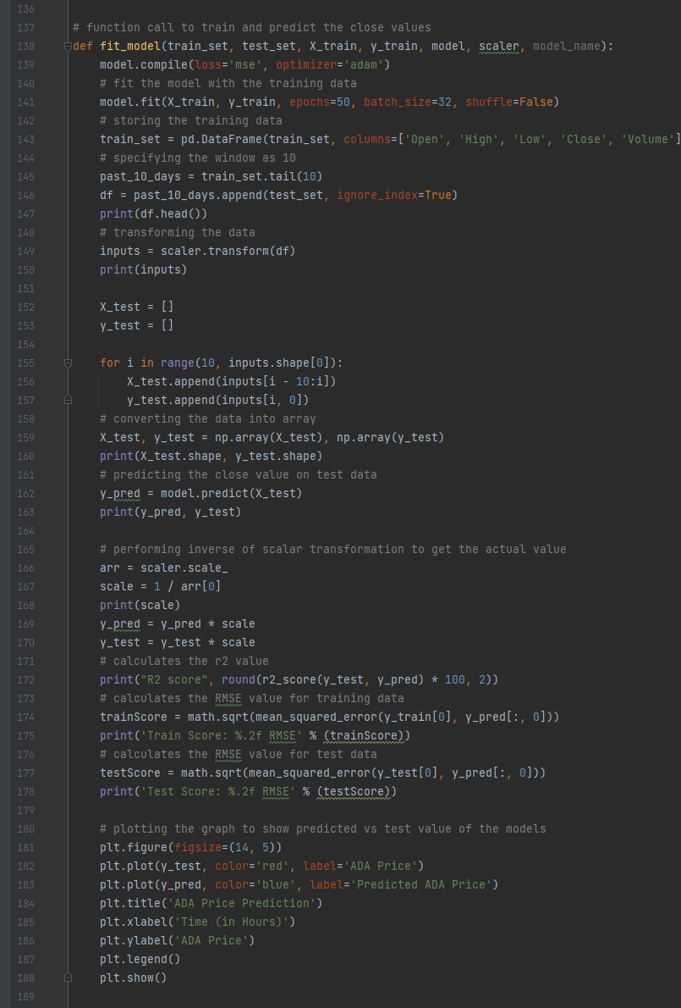
Evaluation and Prediction
Once the model is initialized, we are transforming the training data, we are trying to predict the test data which is calculating the Close Price based on the 10-window size. And we are also evaluating the models built by using RMSE and R^2 value and the graphs for the same are plotted.

Slide 19
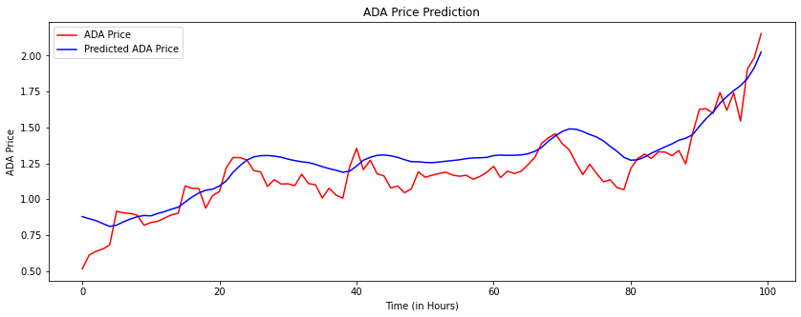
LSTM
R2 score: 73.31
RMSE: 0.79

Slide 20
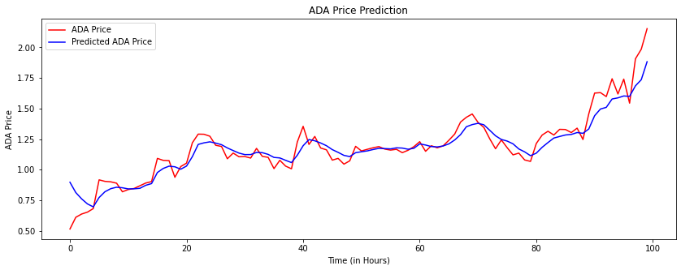
GRU
R2 score: 88.71
RMSE: 0.69

Slide 21
Future Scope
Use the Binance API to extract more data
1
Use the model to develop a trading bot
2
This bot can use indicators like RSI to predict when to sell or buy a share.
3

Slide 22
Conclusion
The GRU model performed better with a higher R2 score and lower RMSE.
This better performance can be attributed to-:
Less complex structure and hence easy to modify
It is computationally more efficient
GRU’s perform better on less training data.

Slide 23

THANK YOU

